Slide 1
CSE 211
Digital Design
Lab07 – Arduino: Usage of LCD and HCSR04 Sensor

Slide 2
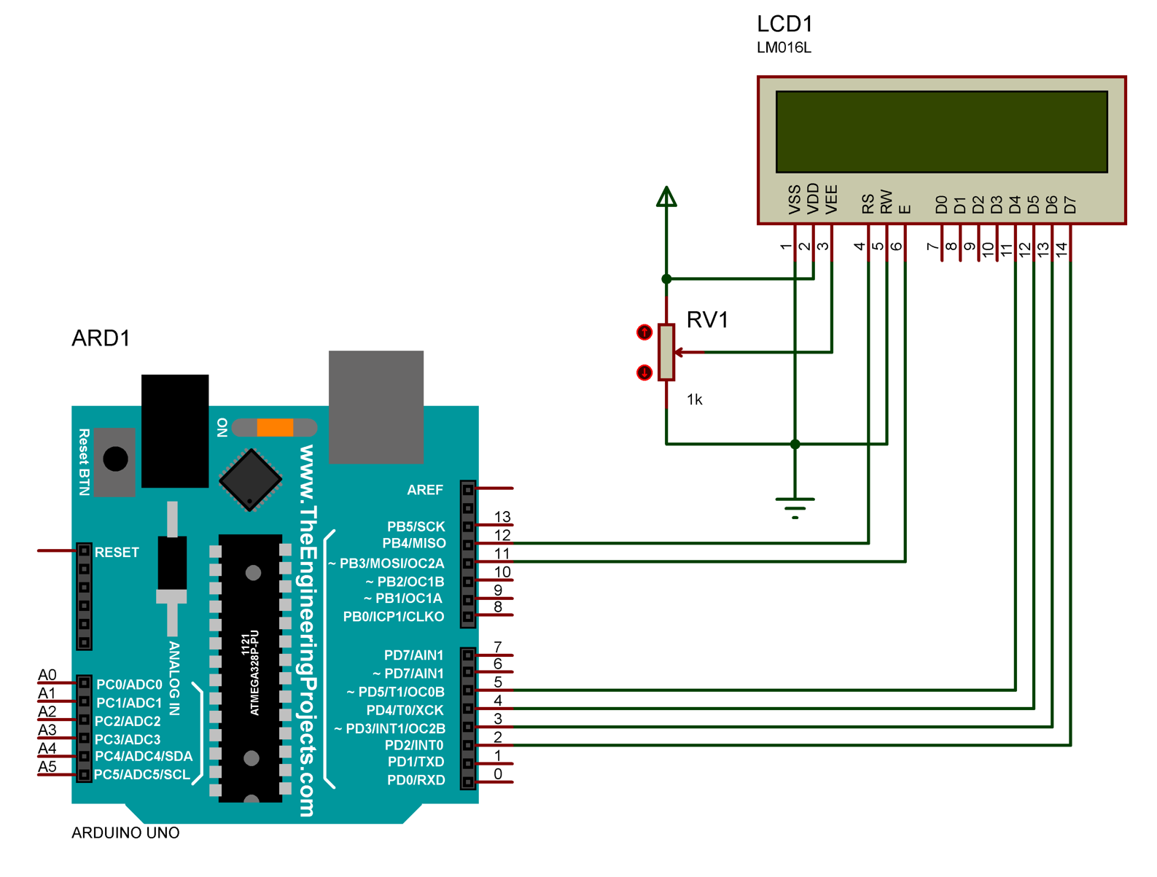
LCD 2x16 “Hello World”
Firstly,print ‘Hello World’ in the first raw of the screen.
Then, keep a counter that increases on every second. Use millis() function.
Tutorial: lin
LCD Library: link

Slide 3
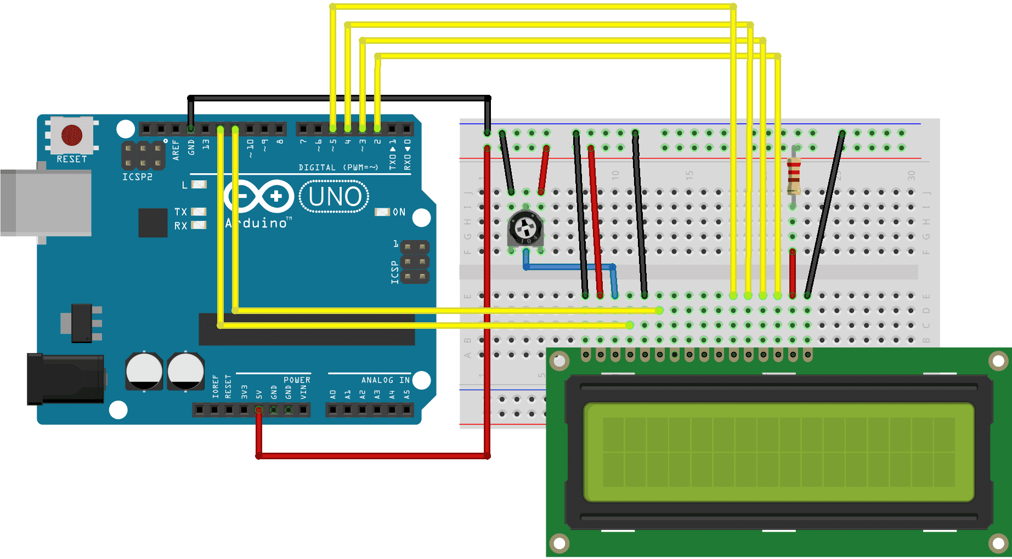
Hello World

Slide 4
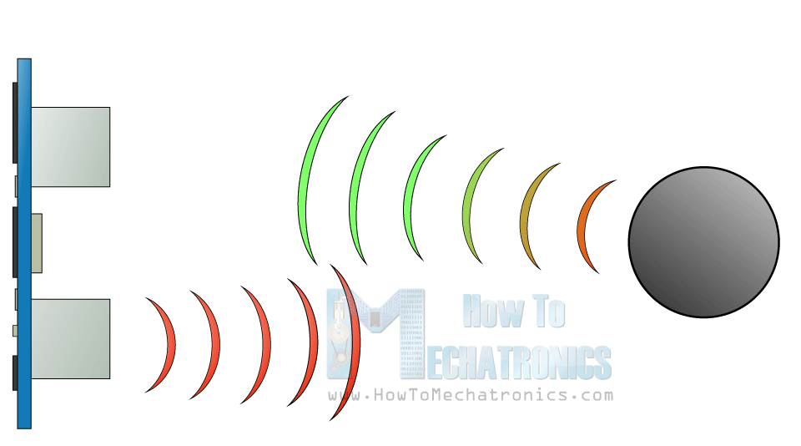
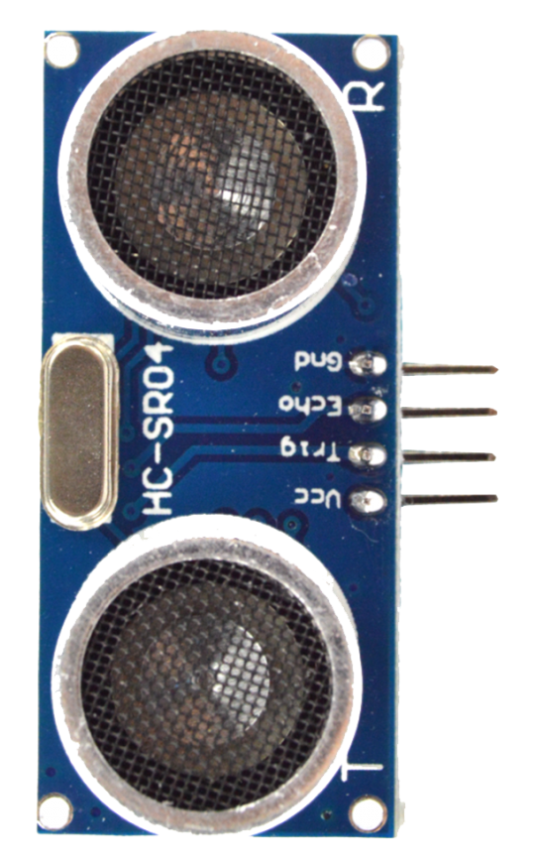
HCSR04 Ultrasonic Distance Sensor
How it works?
It emits an ultrasound at 40.000 Hz which travels through the air and if there is an object or obstacle on its path. It will bounce back to the module. Considering the travel time and the speed of the sound you can calculate the distance.

Slide 5
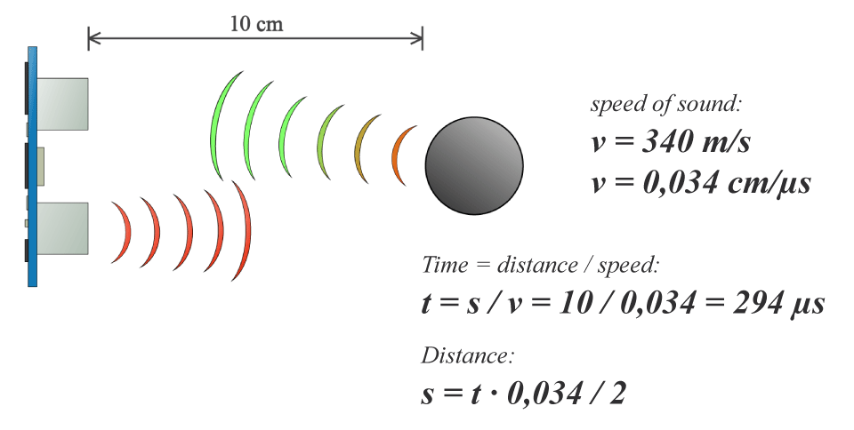
HC-SR04

Slide 6
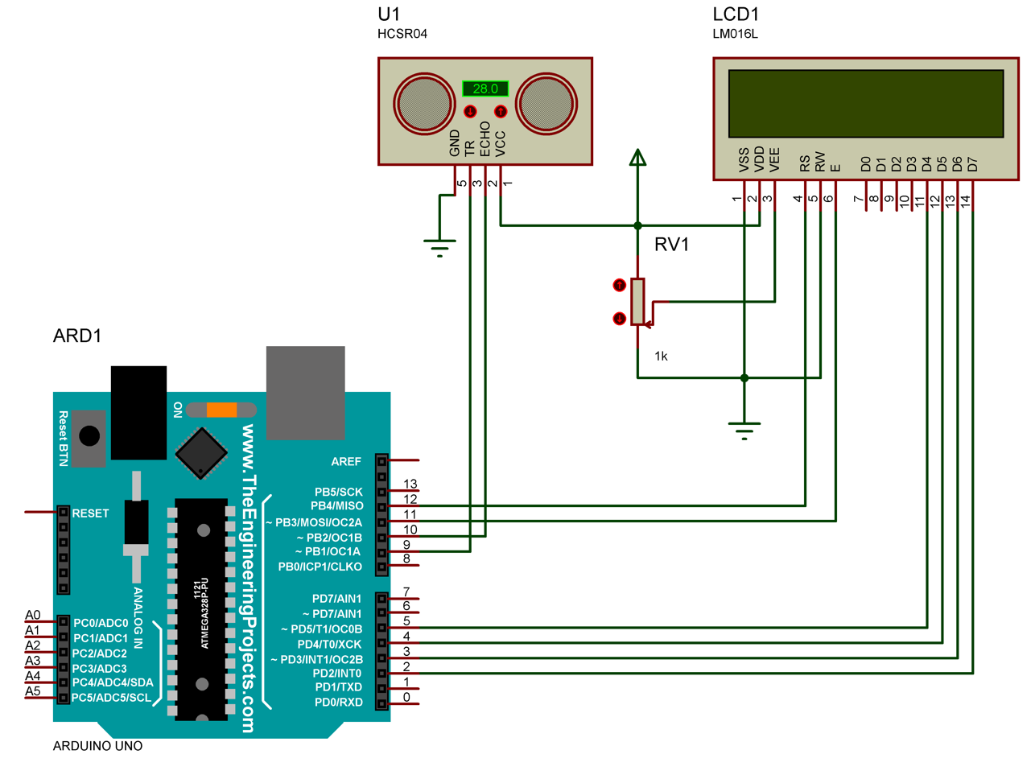
Distance Monitoring
Measure distance with HC-SR04
Print continuously the distance on 2x16 LCD Screen
Tutorial: link

Slide 7
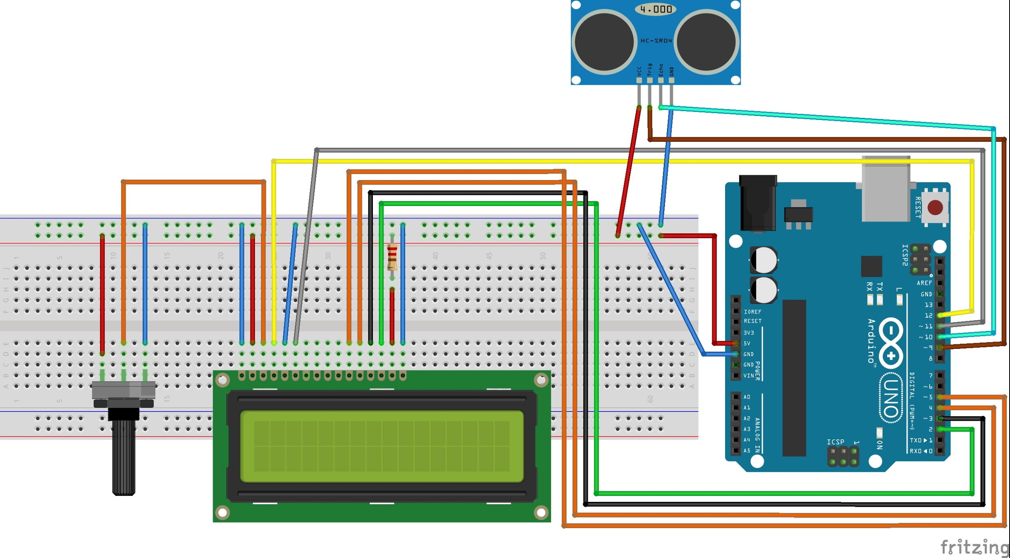
Distance Monitoring

